Slide 1
ChicAI
Dylan Pereira
Farham Khademi
Sharon Dsouza
Smart Wardrobe App
Notes:
The idea we’re building in a

Slide 2

The struggle is real
“I have a lot of clothes, but no outfits!”
“I’m always late because I can’t figure what to wear”
“I have a small budget but I still want to look good”
“I need an outfit for this event but where do I begin?”
“I tear my room apart to find the right outfit”
“I feel like I recently wore this”
“I have a lot of clothes, but no outfits!”
“I’m always late because I can’t figure what to wear”
“I have a small budget but I still want to look good”
“I need an outfit for this event but where do I begin?”
“I tear my room apart to find the right outfit”
“I feel like I recently wore this”
12-17-2024
ChicAI
Notes:
Well, If you have said, thought or relate to any of these lines, then you are our ideal customer and this app is for you!

Slide 3
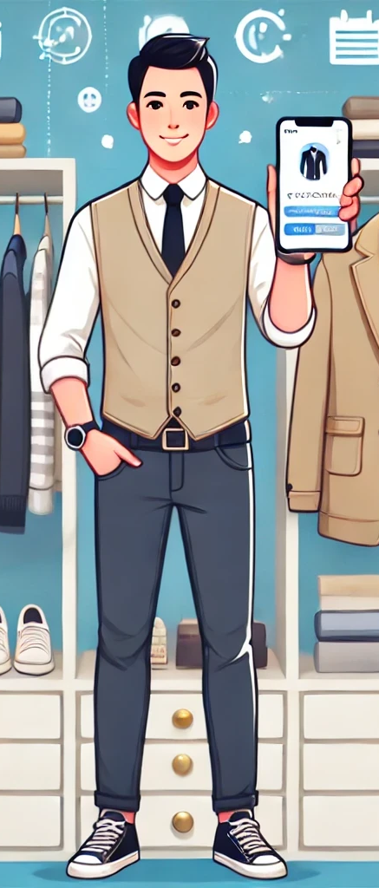
What is ChicAI?
Smart Wardrobe App - Organize, Catalog, and style your wardrobe with AI
Personalized Outfit Suggestions - A Personal Stylist at your fingertips.
Free and Accessible - Free to access and use on Android and iOS OSs.
Effortless Fashion - Simplify your daily outfit choices.
ChicAI
Notes:
Introducing ChicAI, a smart wardrobe app designed to simplify outfit selection and enhance your personal style.
Effortlessly photograph and catalog your entire wardrobe for a personalized, organized inventory.

Slide 4
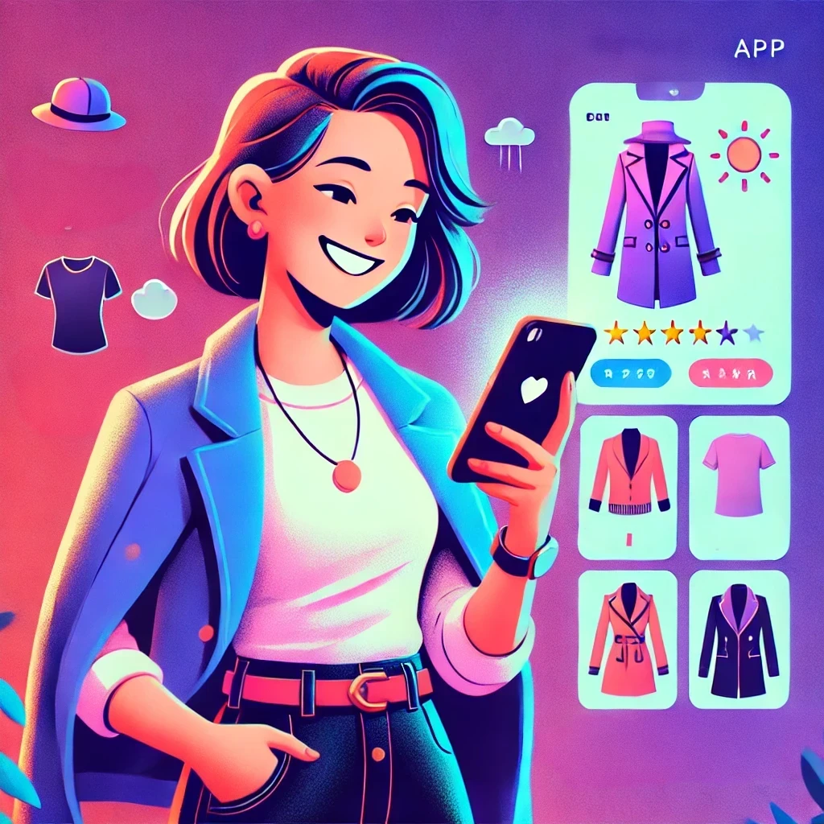
Features:
Expand Your Style Horizon - Discover new outfit combinations.
Effortless Fashion - Eliminate guesswork from your daily wardrobe choices.
Manage Laundry - Mark clothes as “in laundry” to track rotation.
Customize Outfits - Create custom outfits by grouping clothing items.
ChicAI

Slide 5
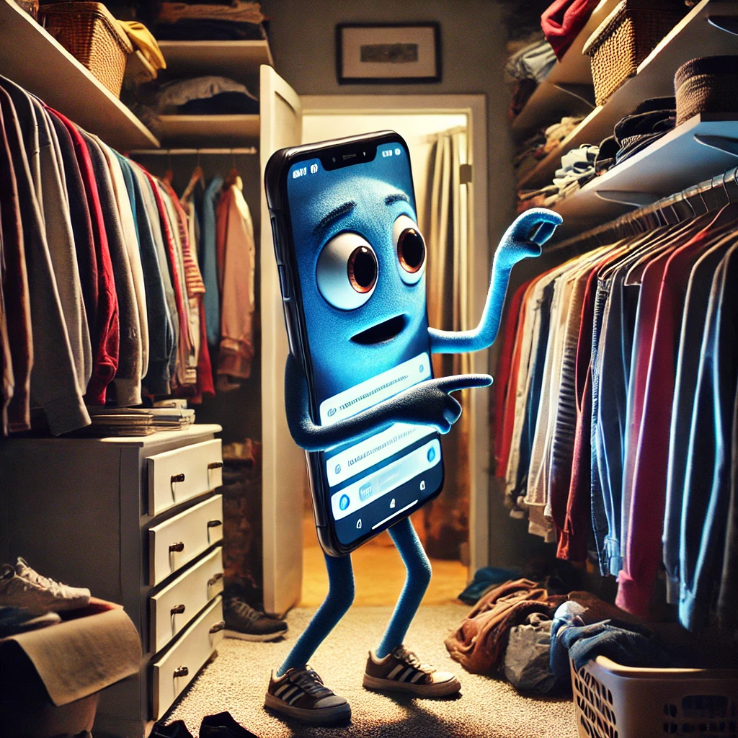
Future Updates
Learning Your Style - Analyzes your wardrobe to understand your taste.
Adapting to Your Needs - Considers your lifestyle, events and weather.
ChicAI

Slide 6

First Time User Expectation
Easy Onboarding - User-friendly setup to guide towards cataloging wardrobe.
Personalized Style Insights - Receive immediate personalized suggestions.
Effortless Navigation - Simple to explore all features.
Customizable Experience - Tailor the app to match your lifestyle.
Instant Gratification - Experience convenience of smart fashion on day one.
12-17-2024
ChicAI

Slide 7

Thank you!
12-17-2024
ChicAI
Notes:
Good work team
Amen

